Slide 1
Microsoft Cloud University Networking Basics
Maya Azar
Cloud Solution Architect
mayaazar@microsoft.com

Slide 2

The Ground Rules
Here to learn
Safe environment to ask your questions
No such thing as a stupid question
No one knows everything
Fun and interactive
Try to answer / guess

Slide 3
Agenda
What is networking and types of networks
OSI & TCP/IP model
Network devices
IP addressing
Azure core networking services

Slide 4
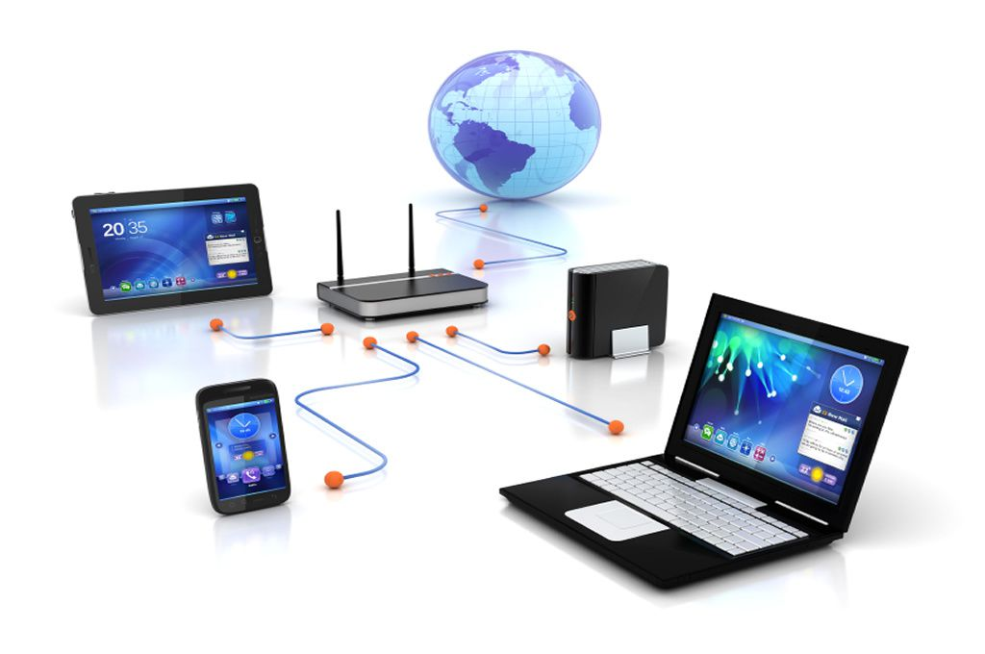
What is a networking?
Networking is connecting 2 or more devices so they can communicate
The network follows protocols which define how communications are sent and received
Devices can be computers, printers, storage devices, phones, tablets, etc…
Number of devices is increasing making networking and connectivity an important utility

Slide 5
Types of network: LAN vs WAN
LAN | WAN
LAN is a computer network that covers a small geographic area, like a home, office, or group of buildings. | WAN is a computer network that covers a broad area. For example, any network whose communications links cross-regional and metropolitan boundaries over a long distance.
Tends to use specific connectivity technologies, like ethernet and wireless. | Uses technologies like Frame Relay and X.25 for connectivity for the longer distances
There is a need to set up a couple of extra devices on the network, so it is not very expensive. | In WAN networks as remote areas have to be connected, hence the set-up costs are higher.
LAN has a higher data transfer rate. | WAN has a lower data transfer rate as compares to LAN.
Ownership of LAN is private. | WAN’s ownership can be private or public.
The speed of LAN is high. | The speed of WAN is slower than LAN.
The propagation delay time is short in LAN. | The propagation delay in WAN is longer than LAN.
Its design and maintenance is easy. | Its design and maintenance is difficult.

Slide 6
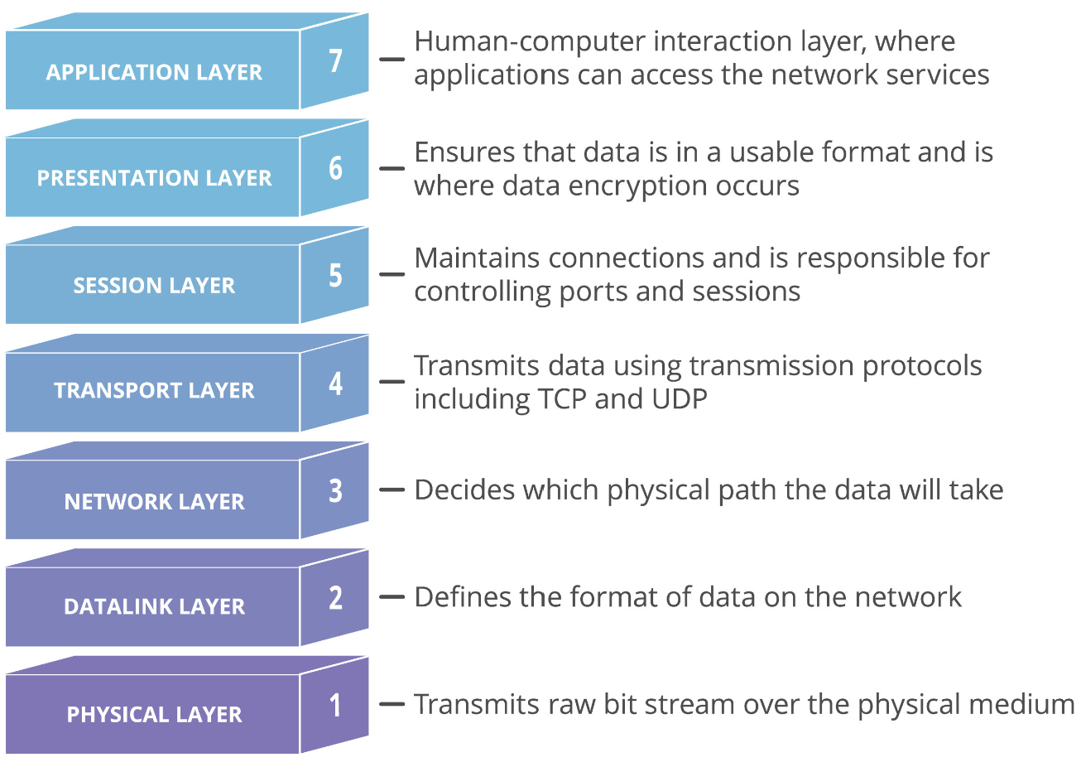
OSI model

Slide 7
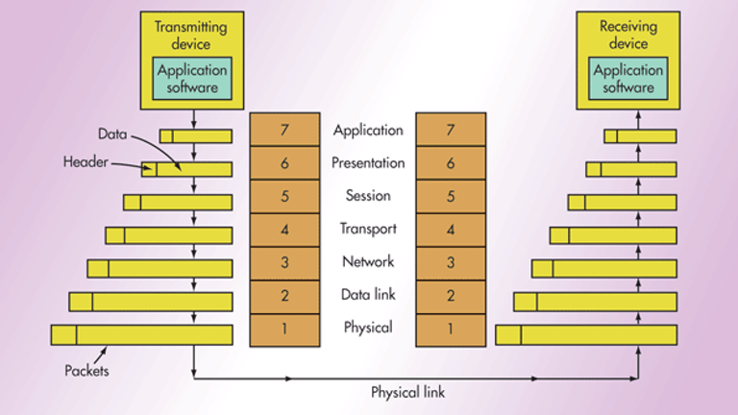
How do computer systems communicate

Slide 8
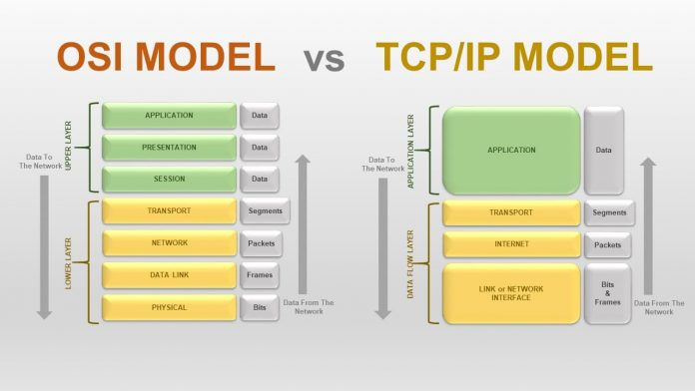
TCP/IP model

Slide 9
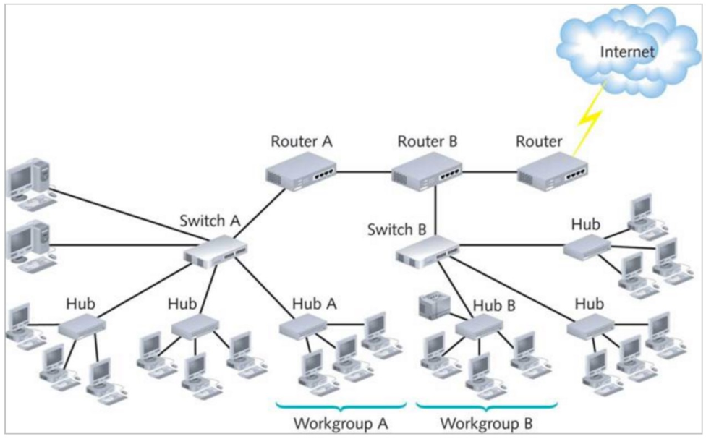
Network devices
Hub: A multiport repeater that sends data to all connected devices
Switch: Smarter than a hub, performs error checking and can forward good packets to the correct port only
Router: Routes data packets based on their IP addresses and connects LAN and WAN together
Access point: connect wireless devices to the network
Firewall: network security devices that monitors incoming and outgoing traffic
Load balancer: distributes traffic across servers to maximize capacity

Slide 10
Quiz
What is the definition of networking?
Can you name the 2 most common types of networks?
Can you name the 7 OSI layers?
Can you name a few network devices?

Slide 11
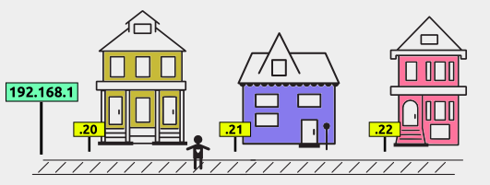
IP addressing
Analogy – house addresses
192 = country
168 = city
1 = street
20 = house number

Slide 12
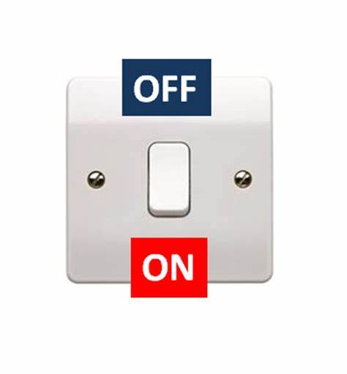
Binary
Binary | 10000000 | 01000000 | 00100000 | 00010000 | 00001000 | 00000100 | 00000010 | 00000001
Decimal | 128 | 64 | 32 | 16 | 8 | 4 | 2 | 1
Bit position | 7 | 6 | 5 | 4 | 3 | 2 | 1 | 0
Power | 2⁷ | 2⁶ | 2⁵ | 2⁴ | 2³ | 2² | 2¹ | 2⁰
Questions
What is 00001010 in decimal?
What is 21 in binary?
What is the largest decimal number you can make with 8 bits?
What is Smallest decimal number you can make with 8 bits?

Slide 13
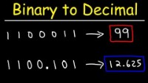
Binary to decimal conversion

Slide 14
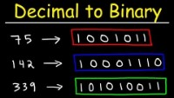
Decimal to binary conversion

Slide 15
IPv4
32 bits = 4,294,967,296 (232) unique addresses ~ 4.3 billion
Represented as 4 x 8 bits (octets)
Binary | Dotted decimal notation
00000001.00000010.00000011.00000100 | 1.2.3.4
11000000.10101000.00000001.0010100 | 192.168.1.20
IPv6
128 bits
Three hundred and forty undecillion, two hundred and eighty-two decillion, three hundred and sixty-six nonillion, nine hundred and twenty octillion, nine hundred and thirty-eight septillion, four hundred and sixty-three sextillion, four hundred and sixty-three quintillion, three hundred and seventy-four quadrillion, six hundred and seven trillion, four hundred and thirty-one billion, seven hundred and sixty-eight million, two hundred and eleven thousand, four hundred and fifty-six
Could assign an IPV6 address to EVERY ATOM ON THE SURFACE OF THE EARTH, and still have enough addresses left to do another 100+ earths
252 addresses for every observable star in the known universe

Slide 16
Classes- Classful IP addressing
Class | First bits | Start | End | Subnet Mask | Hosts per network | Networks
A | 0 | 1.0.0.0 | 126.255.255.255 | 255.0.0.0 | 16 mil | 127
B | 10 | 128.0.0.0 | 191.255.255.255 | 255.255.0.0 | ~65000 | ~16000
C | 110 | 192.0.0.0 | 223.255.255.255 | 255.255.255.0 | 254 | 2 mil
Class | Octet 1 | Octet 2 | Octet 3 | Octet 4
A | Net ID | Host ID
B | Net ID |  | Host ID
C | Net ID |  |  | Host ID

Slide 17
Subnetting
Subnet Mask ‘hides’ part of the Host address space to make more network space
E.G: 255.255.0.0, applied to a Class A address, turns Octet 2 into a network address
This gives you 255 networks with 65k hosts in each
Class | Octet 1 | Octet 2 | Octet 3 | Octet 4
A | Net ID | Host ID
B | Net ID |  | Host ID
C | Net ID |  |  | Host ID

Slide 18
Classless Inter-Domain Routing (CIDR)
Classes were too restrictive
Simply specify how many bits are network and the rest are host
1st address is ‘this network’
Last address is ‘broadcast’ = ‘every host on this network’
CIDR | Mask | Hosts per network | Networks
/32 | 255.255.255.255 | ‘this host’ | 255
/31 | 255.255.255.254 | 0 | 128
/30 | 255.255.255.252 | 2 | 64
/29 | 255.255.255.248 | 6 | 32
/28 | 255.255.255.240 | 14 | 16

Slide 19
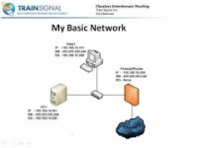
Classless Inter-Domain Routing (CIDR) video

Slide 20
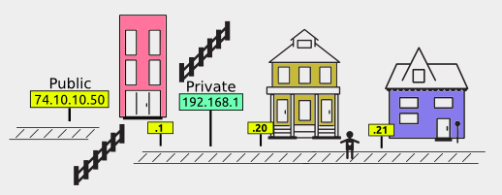
Private vs Public
Analogy – Post Office (pink)
Has a public and a private address
Fence = firewall

Slide 21
Private vs Public
RFC 1918
Name | CIDR block | Address range | Number of addresses
24-bit block | 10.0.0.0/8 | 10.0.0.0 – 10.255.255.255 | 16777216
20-bit block | 172.16.0.0/12 | 172.16.0.0 – 172.31.255.255 | 1048576
16-bit block | 192.168.0.0/16 | 192.168.0.0 – 192.168.255.255 | 65536

Slide 22
Activity – find your own
Private IP address
Physical (Mac) address
Public IP address
Notes:
Ipconfig (ifconfig on Mac/Linux)
Ipconfig /all
https://ip-api.com

Slide 23
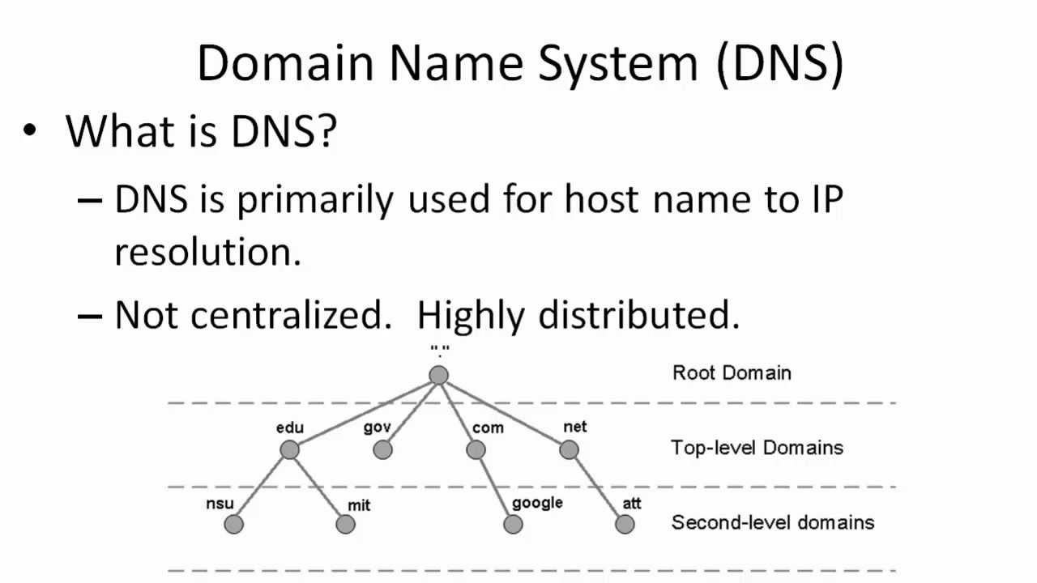
DNS protocol

Slide 24
Azure networking services overview
Connectivity services: Connect Azure resources and on-premises resources using any or a combination of these networking services in Azure - Virtual Network (VNet), ExpressRoute, VPN Gateway, vWAN, Azure DNS, Peering service, and Azure Bastion.
Application protection services: Protect your applications using any or a combination of these networking services in Azure - Load Balancer, DDoS protection, Firewall, Network Security Groups and Web Application Firewall.
Application delivery services: Deliver applications in the Azure network using any or a combination of these networking services in Azure - Content Delivery Network (CDN), Azure Front Door Service, Traffic Manager, Application Gateway and Load Balancer.
Network monitoring: Monitor your network resources using any or a combination of these networking services in Azure - Network Watcher, ExpressRoute Monitor, Azure Monitor, or VNet Terminal Access Point (TAP).

Slide 25
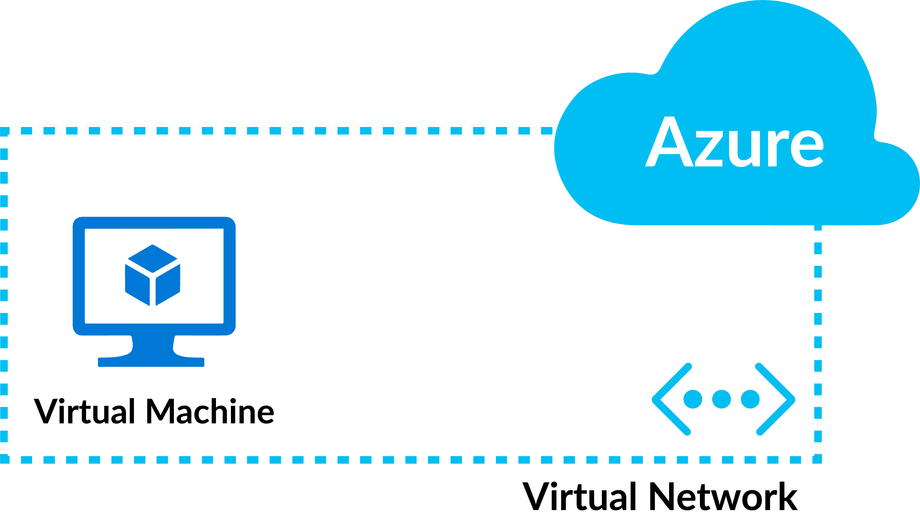
Virtual Network (VNet)
Azure Virtual Network (VNet) is the fundamental building block for your private network in Azure. You can use Vnets to:
Communicate between Azure resources: You can deploy VMs, and several other types of Azure resources to a virtual network.
Communicate between each other: You can connect virtual networks to each other.
Communicate to the internet: All resources in a VNet can communicate outbound to the internet, by default. You can communicate inbound to a resource by assigning a public IP address or a public Load Balancer.
Communicate with on-premises networks: You can connect your on-premises computers and networks to a virtual network with either ExpressRoute or a VPN connectivity.

Slide 26
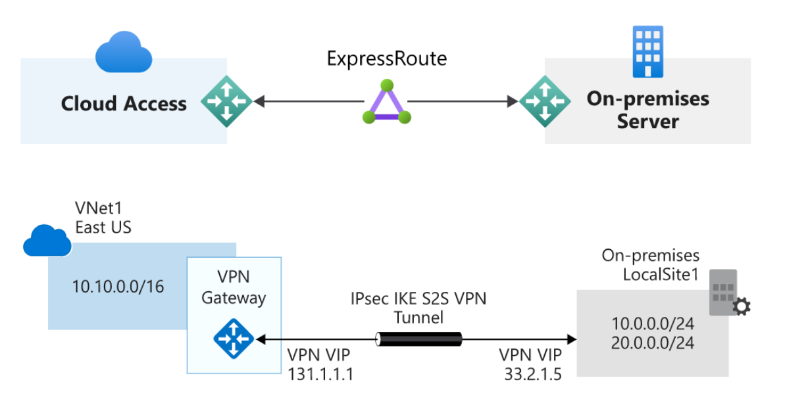
Express Route vs VPN gateway

Slide 27
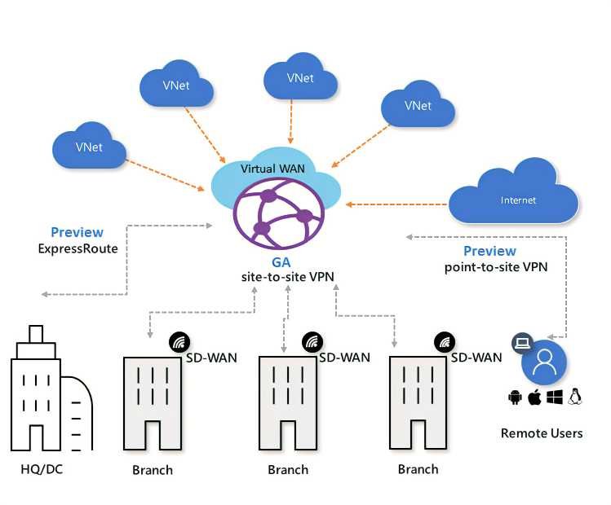
Virtual WAN (vWAN)
Azure Virtual WAN brings together many Azure cloud connectivity services into a single operational interface:
ExpressRoute
Site-to-site VPN
Point-to-site user VPN
There are two types of virtual WANs:
Basic for Site-to-site VPN only
Standard for all connectivity types

Slide 28
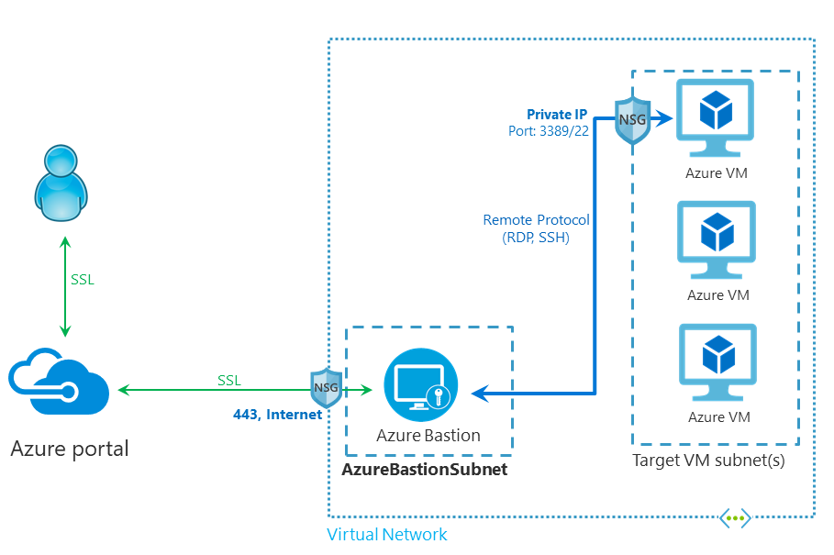
Azure Bastion
This figure shows the architecture of an Azure Bastion deployment. In this diagram:
The Bastion host is deployed in the virtual network that contains the AzureBastionSubnet subnet that has a minimum /26 prefix.
The user connects to the Azure portal using any HTML5 browser.
The user selects the virtual machine to connect to.
With a single click, the RDP/SSH session opens in the browser.
No public IP is required on the Azure VM.

Slide 29
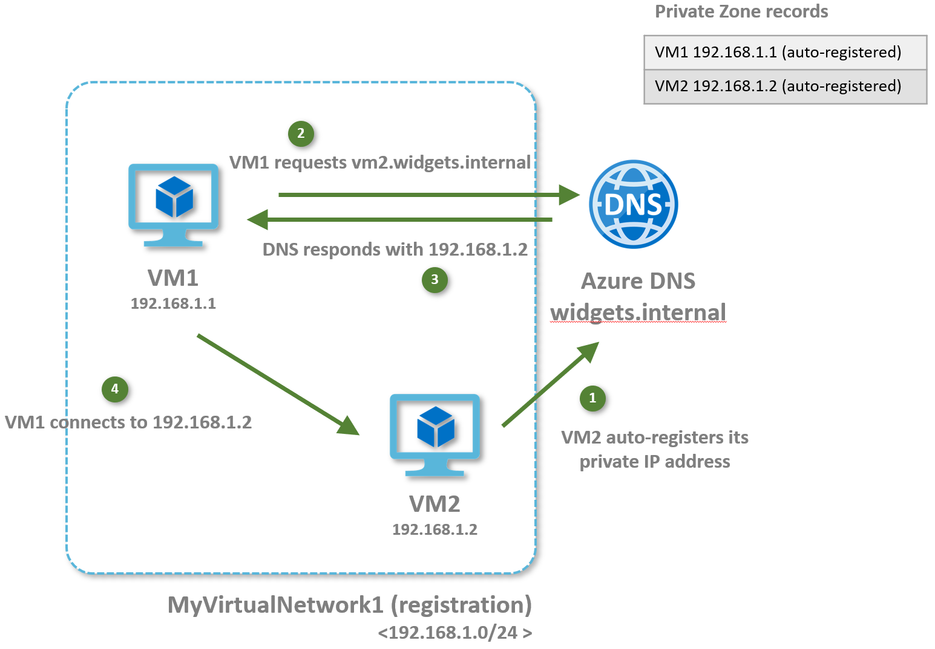
Azure DNS
Azure DNS is a hosting service for DNS domains that provides name resolution.
DNS domains in Azure DNS are hosted on Azure's global network of DNS name servers.
Each DNS query is answered by the closest available DNS server to provide fast performance and high availability for your domain.
Azure DNS supports private and public DNS domain services.

Slide 30
DDoS protection
A distributed denial-of-service (DDoS) is a type of computer attack that uses a number of hosts to overwhelm a server, causing a website to experience a complete system crash.
Azure DDoS Protection can protect applications against targeted DDoS attack. It is simple to enable on any new or existing virtual network, and it requires no application or resource changes.
Azure DDoS Protection has two available SKUs. DDoS Protection Basic and DDoS Protection Standard.
Key features:
Your application traffic patterns are monitored 24 hours a day, 7 days a week, looking for indicators of DDoS attacks.
Intelligent traffic profiling learns your application's traffic over time, and selects and updates the profile that is the most suitable for your service.

Slide 31
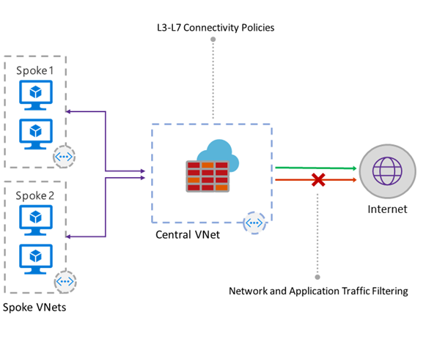
Azure Firewall
A firewall is a network security device that monitors incoming and outgoing network traffic and permits or blocks data packets based on a set of security rules.
Azure Firewall is a cloud-native network firewall for cloud workloads running in Azure.
With Azure Firewall, you can configure:
Application rules that define fully qualified domain names (FQDNs).
Network rules that define source address, protocol, destination port, and destination address.

Slide 32
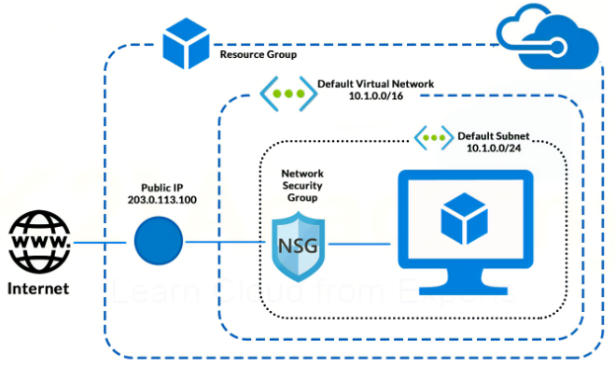
Network Security Group (NSG)
Basic firewall targeted and deployed to particular subnets and/or network interfaces
Contains security rules that allow or deny inbound network traffic to, or outbound network traffic from, several types of Azure resources. For each rule, you can specify source and destination, port, and protocol.

Slide 33
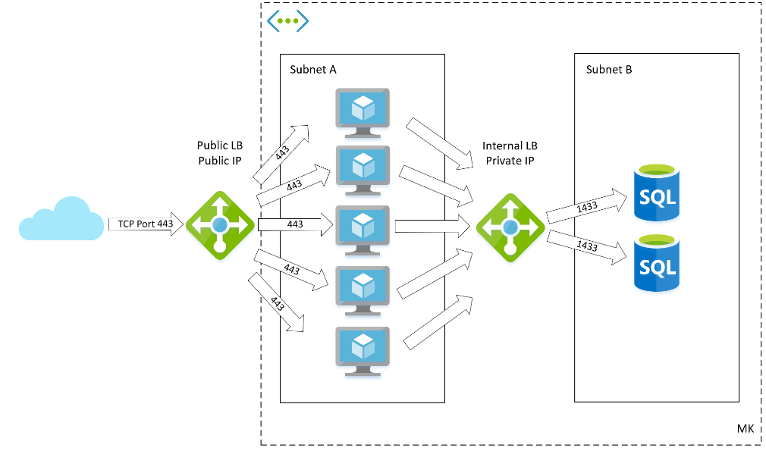
Load balancer
Refers to evenly distributing load (incoming network traffic) across a group of backend resources or servers.
Operates at layer 4 of the OSI model.
Single point of contact for clients.
Backend pool instances can be Azure VMs or instances in a VM scale set.
A public load balancer load balance internet traffic to your VMs.
An internal (or private) load balancer is used where private IPs are needed at the frontend only. Internal load balancers are used to load balance traffic inside a virtual network.

Slide 34
Go Do
Azure networking services overview | Microsoft Learn
https://learn.microsoft.com/en-us/azure/networking/fundamentals/networking-overview
How To Convert Decimal to Binary - Bing video
How To Convert Binary To Decimal - Bing video
Master IP Subnetting (and cloud considerations) - Bing video

Slide 35
Thank you

